Slide 2
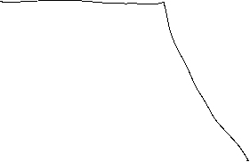








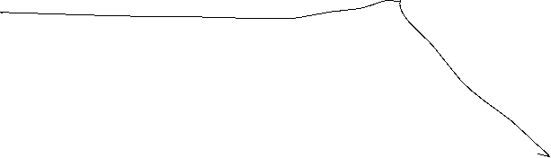


Slide 3
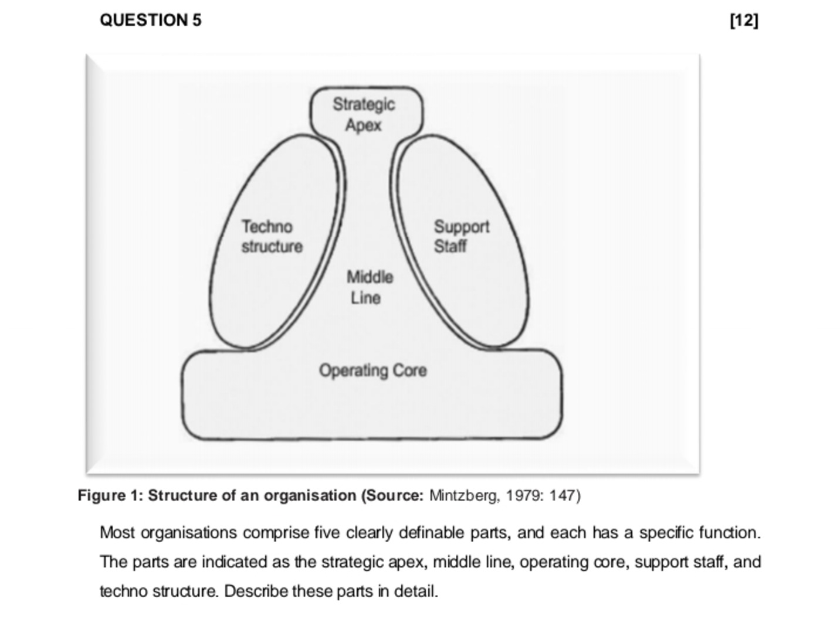





Slide 4
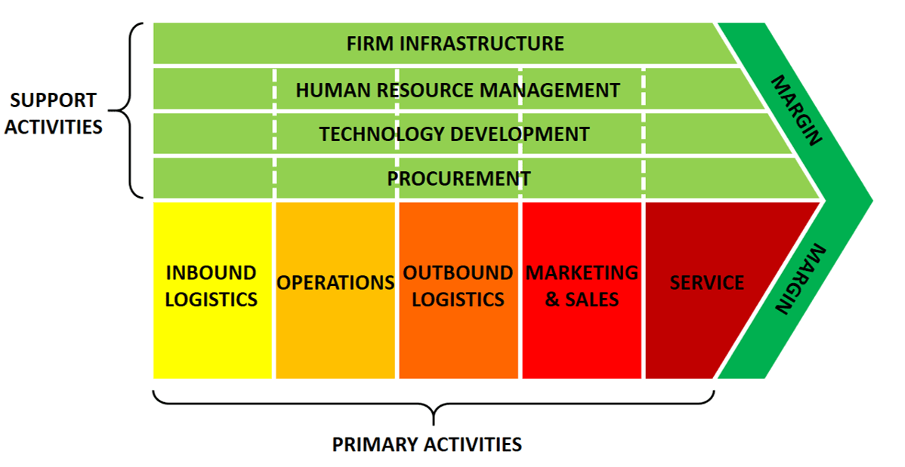


Slide 5















Slide 6




Slide 7
Why are we doing a project?
Strategic
Tactical
Work Breakdown Structure (WBS)
Tactical and a bit of strategic

